Slide 1


Chrestomathy with R
ariel faigon

Slide 2

My quest for a “perfect” language
In the minimalist sense:
  The code does what you say
With nothing beyond the minimal,
essential syntax to achieve the goal

Slide 3
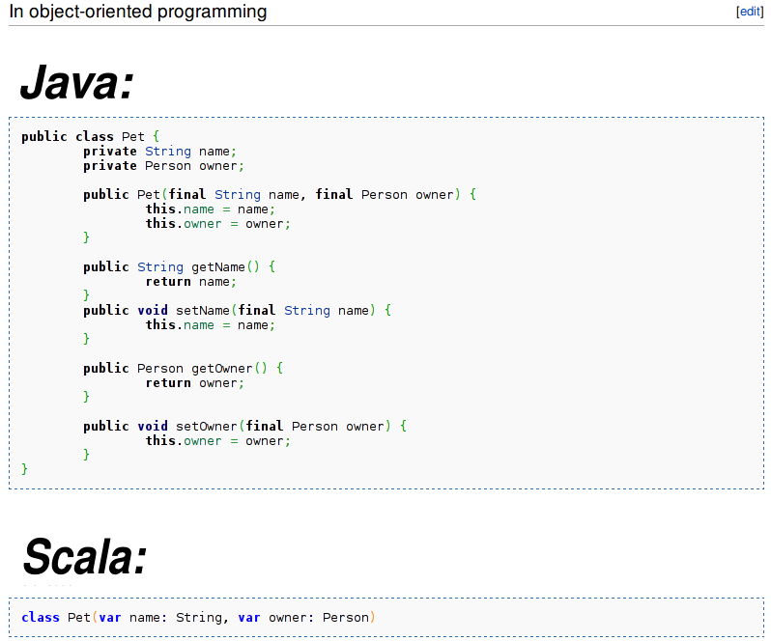
Wikipedia: boilerplate-code

Slide 4
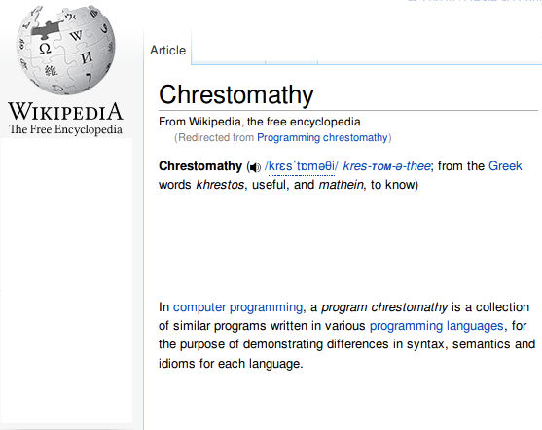
comparative linguistics

Slide 5

Example
“Print the first N squares: 1, 4, 9, 16, 25, ...”
  Easy to state & understand
  Has some iteration/loop in it
  Generic: accepts some parameter
  Even does some IO
Inspiration: a blog post by Steve Yegge

Slide 6
Java
Java version is too long to fit on this page
Reference URL:
http://sites.google.com/site/steveyegge2/lisp-wins
(In a lightning talk, this one has to be skipped...)

Slide 7
C#
Thanks to Peter
int[] v = { 1, 2, 3, 4, 5 };
var squares = v.Select(x => x * x);
foreach (var x in squares)
Console.Write(x.ToString() + " ");
Much more elegant, but can we do better?

Slide 8
Perl & python
Credit: little bro.
perl: print join " ", map {$_ * $_} 1..5
python: print map(lambda n: n*n, range(1, 6))
Semi pure/functional (like LISP), getting there...
Quiz: the above aren't equivalent. How so?

Slide 9
R
cat( (1:5) ^ 2 )
nirvana

Slide 10
Iteration + selection
One of the most common/universal programming constructs:
Select array subset based on some condition
C, C++, C#, Java, Fortran, … (all procedural languages) :
for each element in array[]
If (condition on element is true)
do something with element
SQL: select (element) from table where (condition) ...

Slide 11
R: iteration + selection done right
Select array subset based on some condition
array_name[logical_condition]
Example: Age[Age >= 7.5]
nirvana

Slide 12

R: array[other_array]
Make all “obvious” things implicit
If object is an array → iterate over it
[index] is subset selection
-- Ranges & subsets Scores[west_coast_teams]
-- Boolean conditions Age[Age > 7.5]
With no 'if's, 'for's, iterators, no fluff remains
Programs are typically ~10 times shorter and clearer

Slide 13
Back to our “toy” program
print natural squares up to N:
cat( (1:5) ^ 2 )
Way too trivial?
What if I want, say, a chart of the squares?

Slide 14
But what if I want a chart?
just replace 'cat' with 'plot':
plot( (1:5) ^ 2 )
nirvana

Slide 15
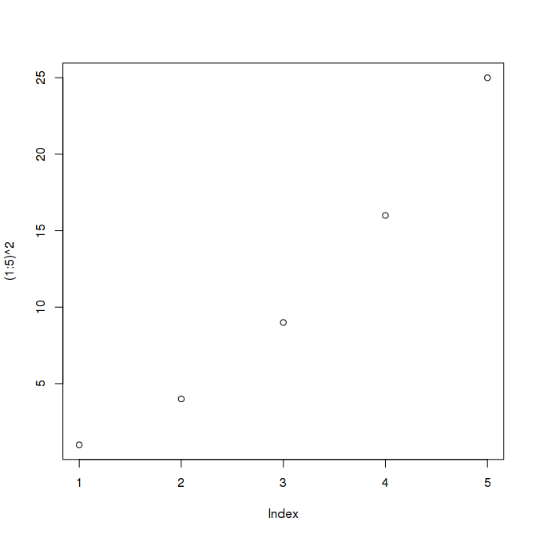
But what if I want a chart?
plot( (1:5) ^ 2 )
(Yes, it is ugly... so let's beautify)

Slide 16
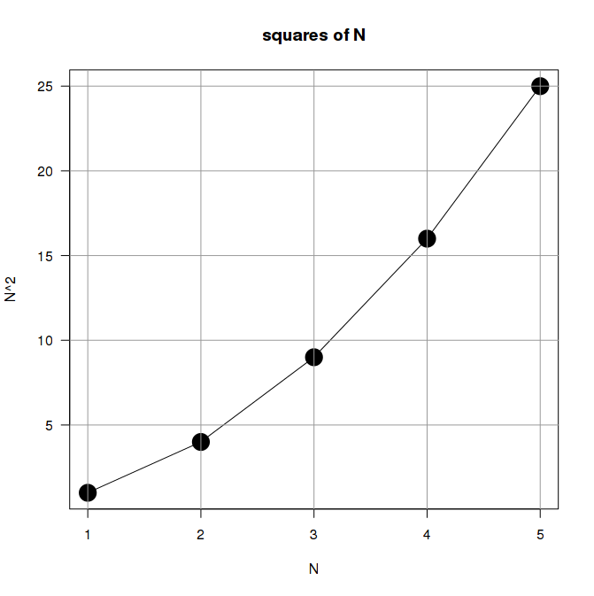
But what if I want a chart?
plot( (1:5) ^ 2 , …); grid(...)
(just change defaults & it looks much better)

Slide 17
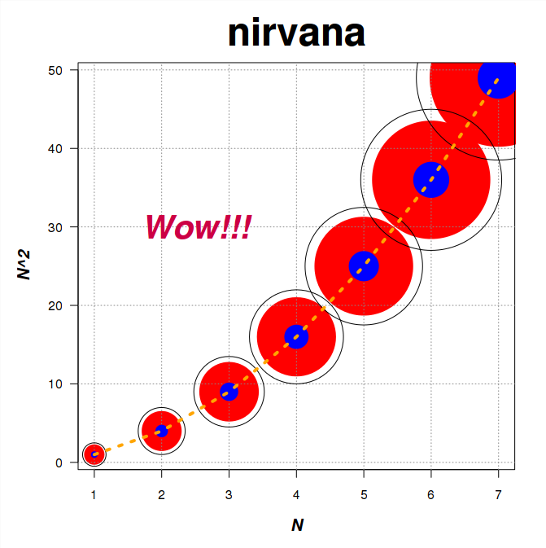
“what if I want a …” demo
- 7 instead of 5
- data-points as cute circles
- radius growing as N
- area → as square(N)
- title and axis labels
- a grid
- fancy concentric circles
- some filled, some hollow
- a dashed line over centers
- a “Wow!!!”
All wishes come true
In just a few lines of R code
(See demo.R)

Slide 18
demo.R: “what if I want a …”
my.prompt ← function(promt=”\n[hit enter to continue]: “) {
cat(prompt, sep='')
invisible(readline())
}
demo.me ← function(title, expr.str) {
cat(title, “\n”, rep('=', nchar(title)), “\n”, sep='')
cat('R> ', expr.str, sep='')
my.prompt(' ')
cat(eval(parse(text=expr.str)), sep=' ')
my.prompt(“\n\n”)
}
...
demo.me(
“Nicer red N-sqared sized circles”,
'plot(Squares, pch=20, col=”red”, cex=Ns*5)'
)
...

Slide 19
from language to platform
R is pure-functional, generic, and extensible
functions are generic/polymorphic and w/o side-effects on callers, plus introspective
It was a small language when it started, but it was cleanly extensible
Has 4074 libraries (CRAN, last check) and it keeps growing
Without breaking under the strain/complexity of additions

Slide 20
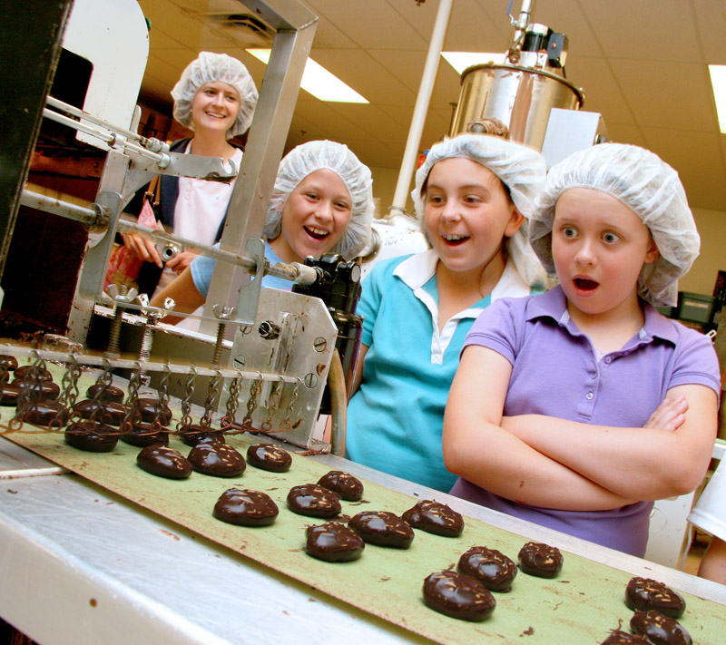
R is a factory
Give a man a fish – he will eat for a day
Teach a man how to fish – he can eat his whole life
Give a man tools – he can make a fishing pole...
(Guy L Steele Jr.)

Slide 21
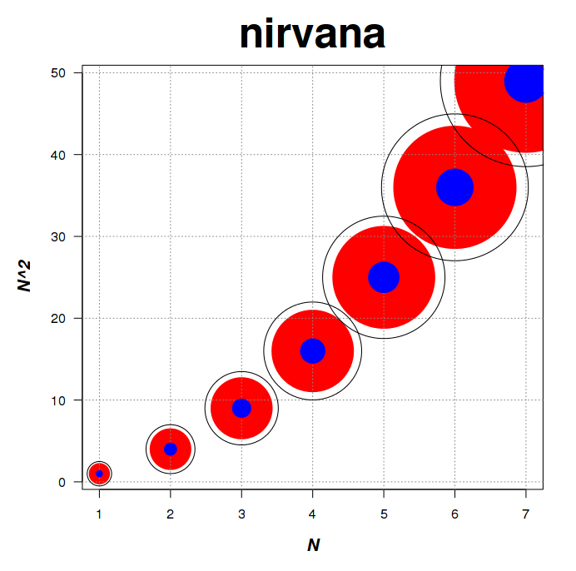
Despite all its warts
R minimalism shines
Questions?

